Slide 1
Version Control Systems

Slide 2
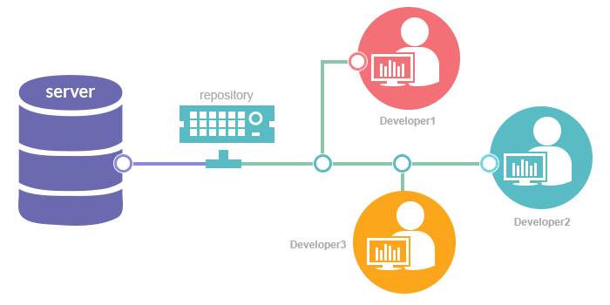
Agenda
Version Control System
Why we need VCS?
Git - Industry adopted
Gitlab - Self hosted code repository
Git tutorial
Collaborative Development
Merge / Pull Request - Code Review

Slide 3
What is Version Control?
You can think of a version control system (short: "VCS") as a kind of "database".
It lets you save a snapshot of your complete project at any time you want.
When you later take a look at an older snapshot (let's start calling it "version"), your VCS shows you exactly how it differed from the previous one.

Slide 4
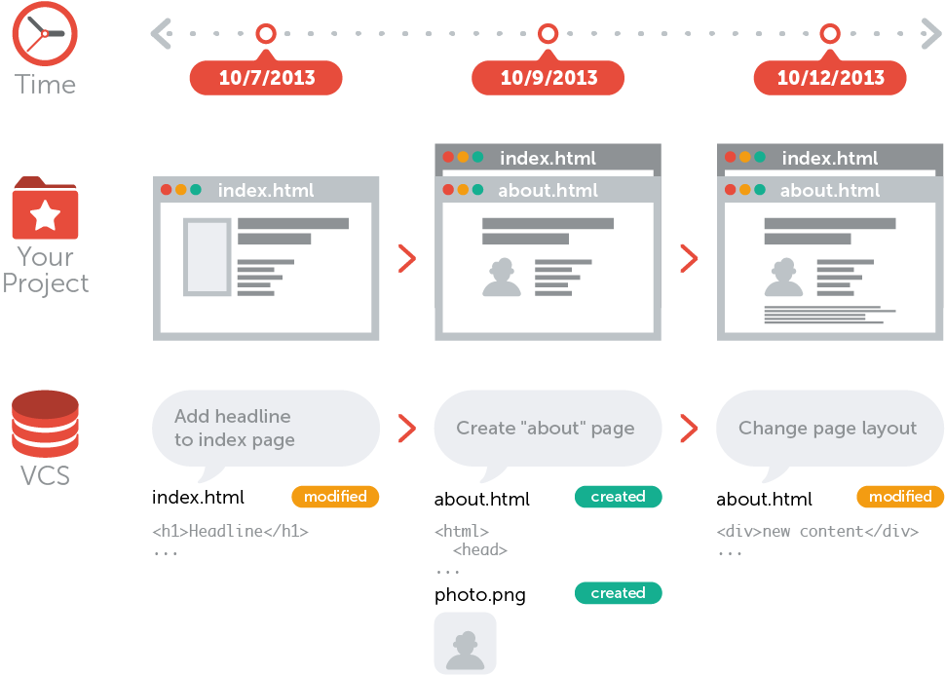
What is Version Control?

Slide 5
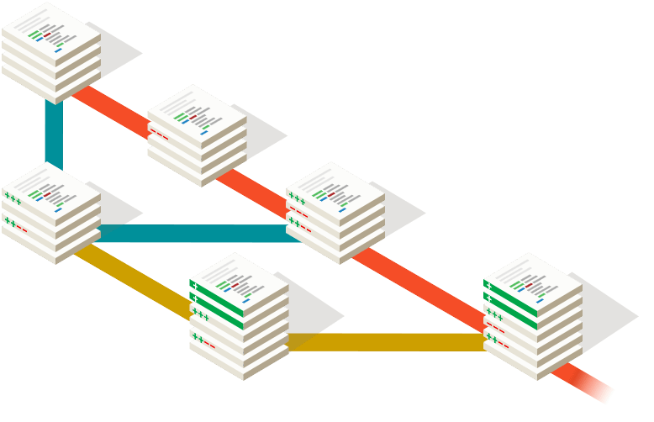
What is Version Control?
Version control is independent of the kind of project / technology / framework you're working with:
It works just as well for an HTML website as it does for a design project or an iPhone app
It lets you work with any tool you like; it doesn't care what kind of text editor, graphics program, file manager or other tool you use
Also, don't confuse a VCS with a backup or a deployment system.
You don't have to change or replace any other part of your tool chain when you start using version control.

Slide 6
Why we need a VCS?
Version control can also enable developers to move faster and it allows software teams to preserve efficiency and agility as the team scales to include more developers.
There are many benefits of using a version control system for your projects. Some of them are:
Collaboration
Version Storage
Restoring versions
Traceability
Branching and Merging
Backup

Slide 7
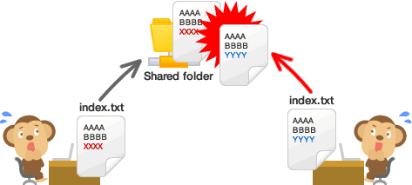
Collaboration
Without a VCS in place, you're probably working together in a shared folder on the same set of files.
It's extremely error-prone as you're essentially doing open-heart surgery all the time: sooner or later, someone will overwrite someone else's changes.

Slide 8
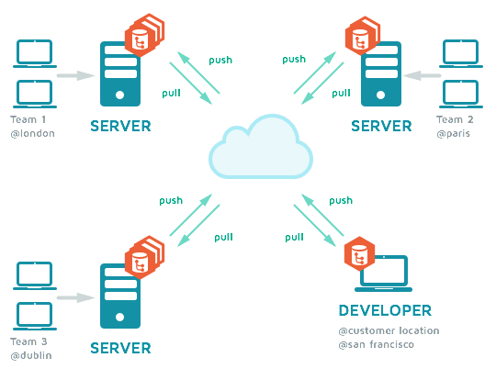
Collaboration
With a VCS, everybody on the team is able to work absolutely freely - on any file at any time.
The VCS will later allow you to merge all the changes into a common version.
Other benefits of using a VCS are even independent of working in a team or on your own.

Slide 9
Storing Versions (Properly)
Saving a version of your project after making changes is an essential habit. Here are some fundamental questions related to version storage:
How much do you save? Only the changed files or the complete project?
How do you name these versions?
The most important question, however, is probably this one: How do you know what exactly is different in these versions?

Slide 10
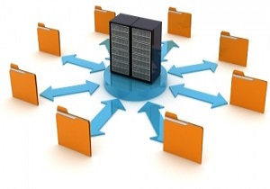
Storing Versions (Properly)
A version control system acknowledges that there is only one project.
Therefore, there's only the one version on your disk that you're currently working on.
Everything else - all the past versions and variants - are neatly packed up inside the VCS.
When you need it, you can request any version at any time and you'll have a snapshot of the complete project right at hand.

Slide 11
Restoring Previous Versions
Being able to restore older versions of a file (or even the whole project) effectively means one thing: you can't mess up!
If the changes you've made lately prove to be garbage, you can simply undo them in a few clicks.

Slide 12

Traceability
Can enable developers to make correct and harmonious changes that are in accord with the intended long-term design of the system.
This can be especially important for working effectively with legacy code and is crucial in enabling developers to estimate future work with any accuracy.

Slide 13
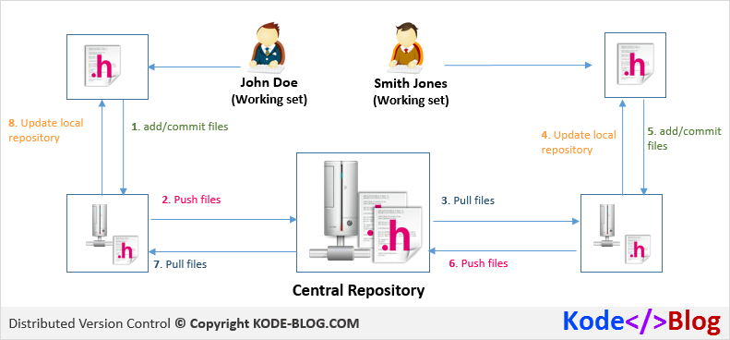
Traceability

Slide 14
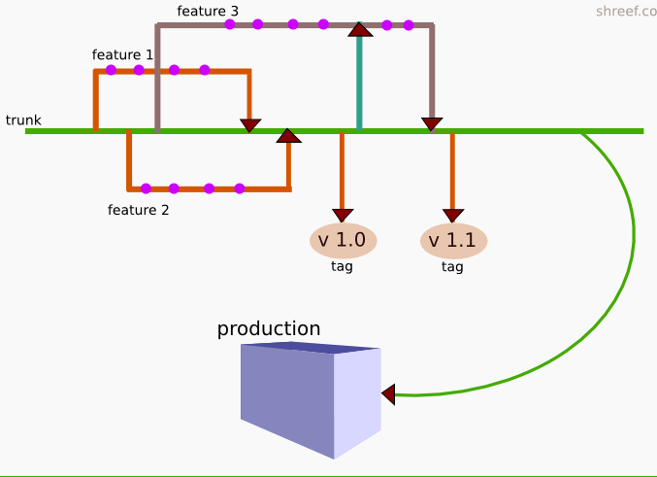
Branching and Merging
Creating a "branch" in VCS tools keeps multiple streams of work independent from each other.
Also provides the facility to merge that work back together, enabling developers to verify that the changes on each branch do not conflict.

Slide 15
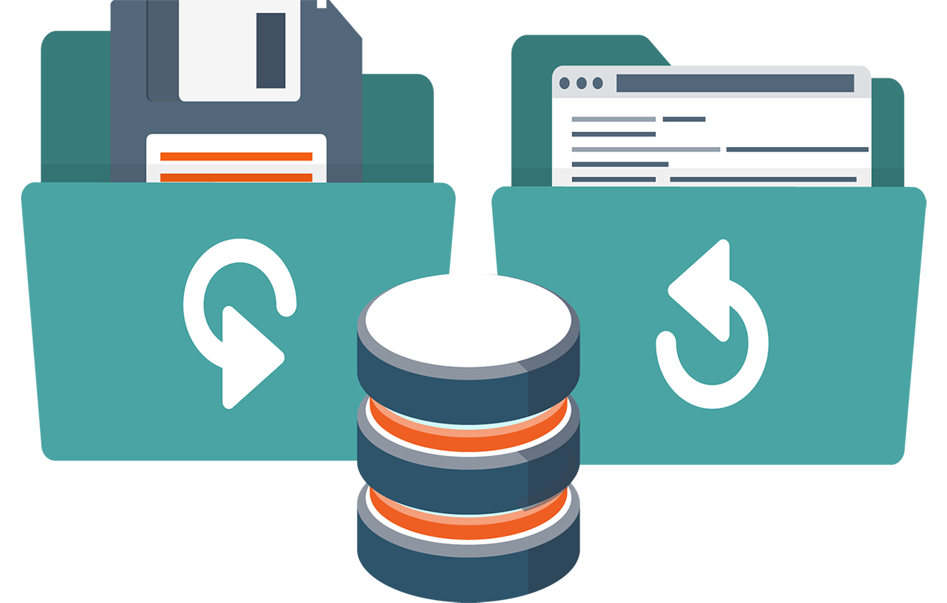
Backup
A good side-effect of using a distributed VCS like Git is that it can act as a backup; every team member has a full-blown version of the project on his disk - including the project's complete history.
Should your beloved central server break down (and your backup drives fail), all you need for recovery is one of your teammates' local Git repository

Slide 16
Version Control System in the Industry - Git

Slide 17

What is Git?
Git is a free and open source distributed version control system designed to handle everything from small to very large projects with speed and efficiency.
In addition to being distributed, Git has been designed with performance, security and flexibility in mind.

Slide 18
Why Git?
Branching and Merging
The Git feature that really makes it stand apart from nearly every other SCM out there is its branching model.
Git allows and encourages you to have multiple local branches that can be entirely independent of each other. The creation, merging, and deletion of those lines of development takes seconds.
Small and Fast
Git is fast. With Git, nearly all operations are performed locally, giving it a huge speed advantage on centralized systems that constantly have to communicate with a server somewhere.

Slide 19
Why Git?
Distributed
This means that instead of doing a "checkout" of the current tip of the source code, you do a "clone" of the entire repository.
Data Assurance
Every file and commit is checksummed and retrieved by its checksum when checked back out. It's impossible to get anything out of Git other than the exact bits you put in.
Free and Open Source

Slide 20
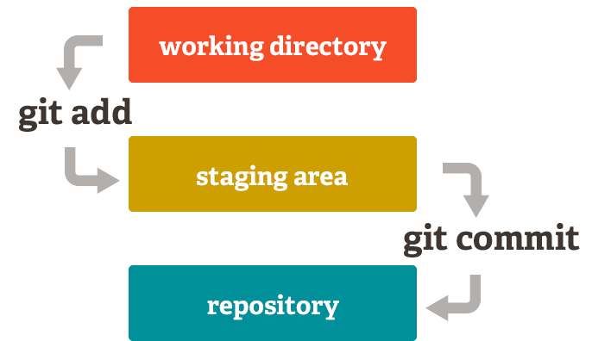
Why Git?
Staging Area
Git has something called the "staging area" or "index". This is an intermediate area where commits can be formatted and reviewed before completing the commit.
This allows you to stage only portions of a modified file.
Now you can just stage the change you need for the current commit and stage the other change for the next commit.

Slide 21
Gitlab - Self hosted code repository

Slide 22

Gitlab
GitLab is a web-based Git-repository manager with wiki and issue-tracking features, using an open-source license, developed by GitLab Inc.
a great way to manage git repositories on a centralized server.
GitLab gives you complete control over your repositories or projects and allows you to decide whether they are public or private for free.

Slide 23
Gitlab
With Gitlab, you can:
Get your best ideas into development.
Securely write and manage code and project data.
Spot errors sooner, improve security and shorten feedback cycles with built-in static code analysis, code testing, code quality, dependency checking and review apps
Manage custom container images with ease.
Minimize complexity with built-in Continuous Delivery.
Automate configuration management
Monitor and manage application performance.

Slide 24
Git - Tutorial

Slide 25
Git - Installation

Slide 26
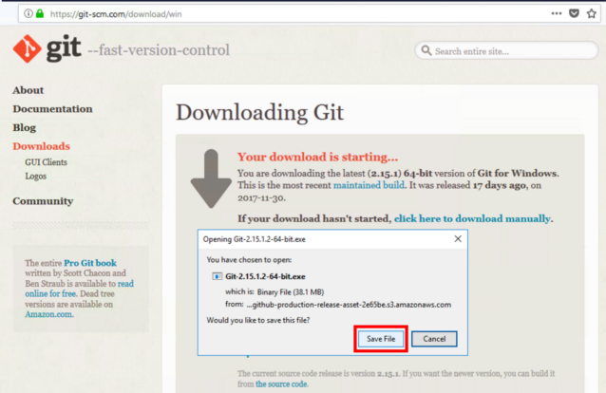
Installing Git
One of the best ways to install Git is by using Git for Windows stand-alone installer.
Go to the following website: https://git-scm.com/download/win.
If the download doesn’t start automatically, then click on “click here to download automatically”.

Slide 27
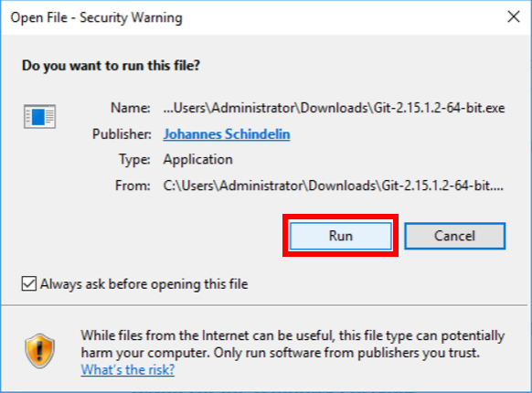
Installing Git
Run the downloaded executable.
Click on “Run” if you see a security warning.

Slide 28
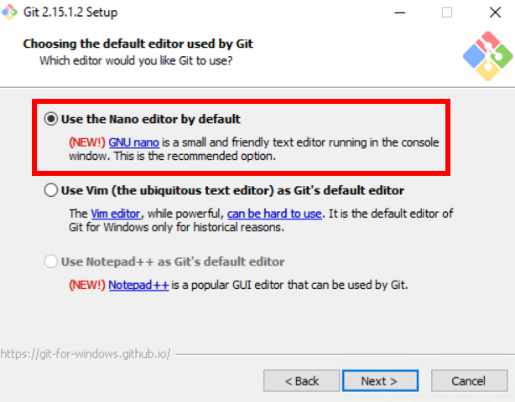
Installing Git
Go through the default installation process until you get to “Choosing the default editor used by Git”.
The default “Use Vim” maybe too hard to use for you if you don’t already know Vim. Choose Nano or Notepad++ which are easier to use.

Slide 29
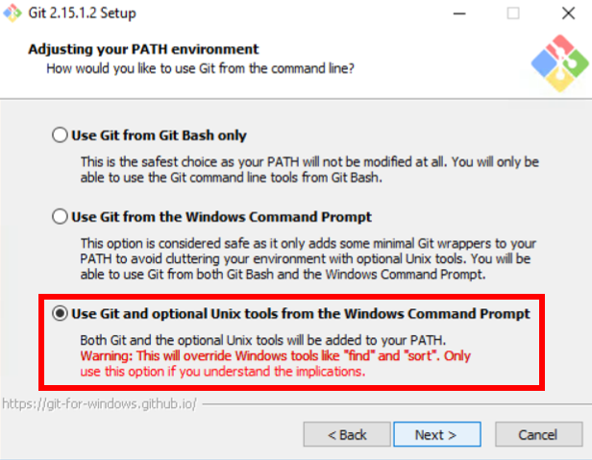
Installing Git
Choose “Use Git and optional Unix Tools”.
This will provide you Unix commands like “ls” and “cat”.

Slide 30
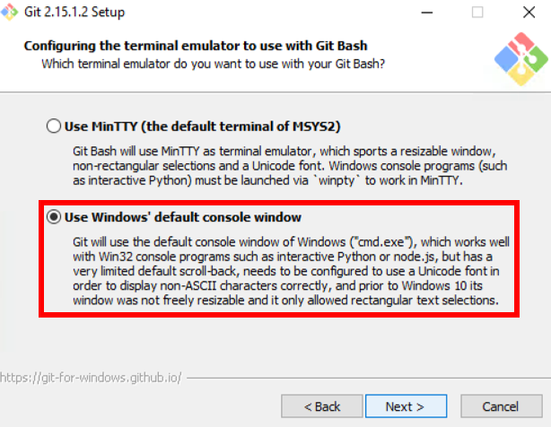
Installing Git
Choose “Use Windows’ default console window.

Slide 31
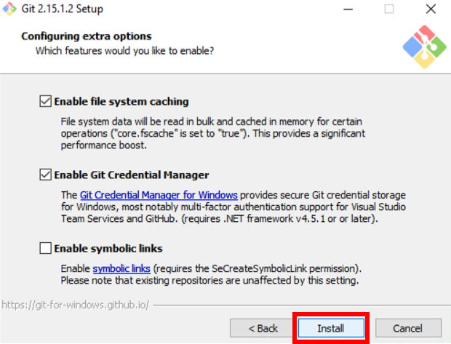
Installing Git
Click on “Install”.

Slide 32
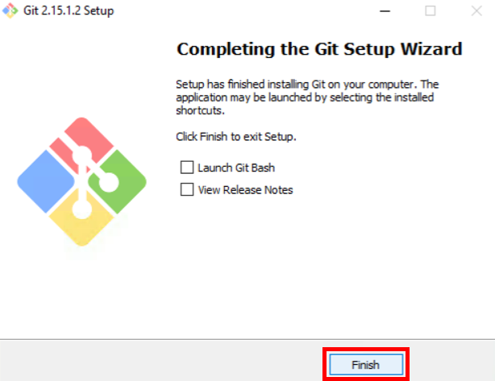
Installing Git
Click on “Finish”

Slide 33
Setting up global variables
Once your Git is installed, Open a Command Prompt (or Git Bash if during installation you elected not to use Git from the Windows Command Prompt).
Run the commands shown to configure your Git username and email.
Replace Emma's name with your own.
These details will be associated with any commits that you create,
git config --global user.name "Emma Paris"
git config --global user.email "eparis@atlassian.com"

Slide 34
Getting Started with Git.

Slide 35
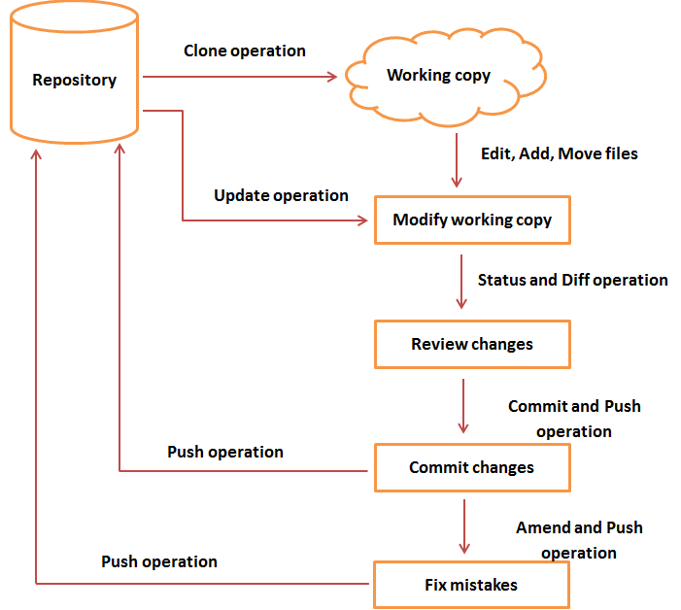
Git Workflow
General workflow is as follows:
You clone the Git repository as a working copy.
You modify the working copy by adding/editing files.
If necessary, you also update the working copy by taking other developer's changes.
You review the changes before commit.
You commit changes. If everything is fine, then you push the changes to the repository.
After committing, if you realize something is wrong, then you correct the last commit and push the changes to the repository.

Slide 36
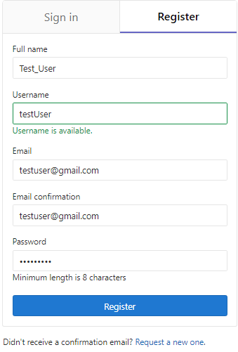
Non-Admin Members - Registration
If you’re not the administrator, to access the repository, you would need to register.
Go to the Login Page on http://13.127.92.221/
Click on Register and Fill Up the required fields.
Once filled, click on “Register” button and you will receive a confirmation email.
Use the Email and password that you used to create the account to login.
If you are already added to an existing repository, you would see the corresponding project on your dashboard.

Slide 37
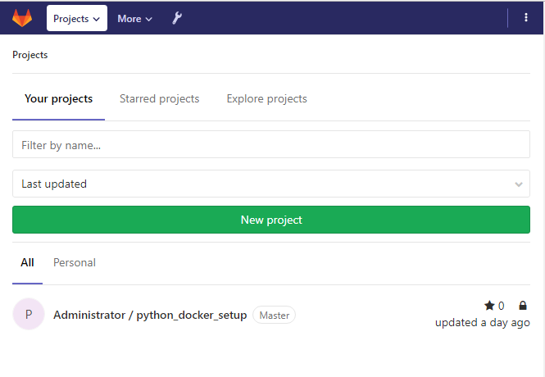
Create a Git Project
When you make files for your project, you’ll want to keep them in one place and shareable with teammates, no matter where they are
With Git, that means adding everything to a repository. Let’s create one!
Go to the Projects Dashboard on http://13.127.92.221/ and click on “New Project”

Slide 38
Create a Git Project
Initially, the repository you create is going to be empty without any code in it.
This repository will be the central repository for your files, which means that others can access that repository if you give them permission.
After creating a repository, you'll copy a version to your local system—that way you can update it from one repo, then transfer those changes to the other.

Slide 39

Create a Git repository
Do the following to create your repository:
Fill up the Project name
Git uses this Name in the URL of the repository.
Give a brief description of the project.
This is optional.
As for the Visibility level, leave it as “Private”
A private repository is only visible to you and those you give access to.
Click on Create Project

Slide 40
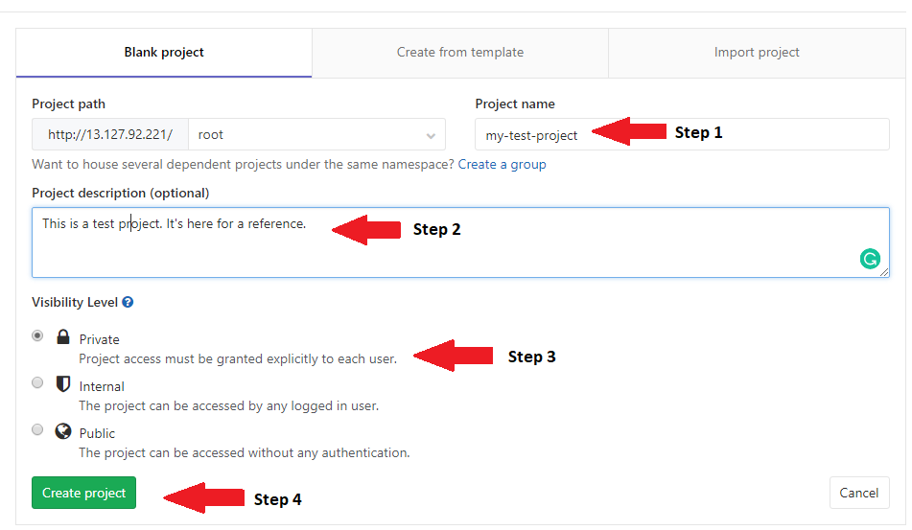
Create a Git repository

Slide 41
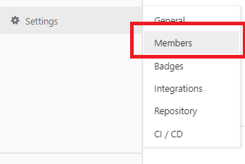
Admin: Adding Members
Once created, if you’re the administrator, it’s time to add members.
Click on the newly created project in the Projects dashboard.
Once you’re redirected to the project dashboard,
Scroll down to Settings
Under the settings tab, click on “Members”.
Under the “Add Members” Tab:
Fill up the Member Details to be added
Email ID - if you’re inviting a new member.
If the member has already registered, add them by clicking on the profile suggestions.
Change the role permission as Master and
Click on Add to Project

Slide 42
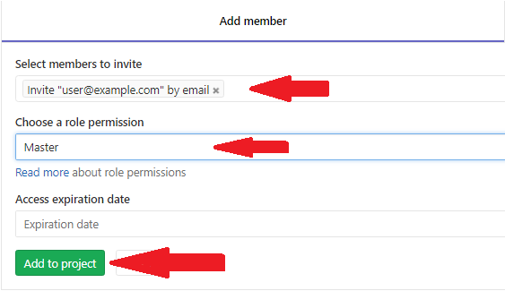

Slide 43
Copy your Git repository and add files

Slide 44
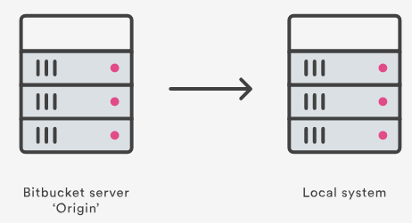
Copying and Creating files in the Repository
Now that you have a place to add and share your space station files, you need a way to get to it from your local system.
To set that up, you want to copy the repository to your system.
Git refers to copying a repository as "cloning" it.
When you clone a repository, you create a connection between the server (which Git knows as origin) and your local system.

Slide 45
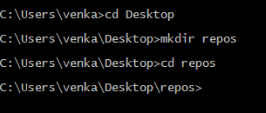
Cloning the Repository
Step 1. Clone your repository to your local system
Open a browser and a terminal window from your desktop. After opening the terminal window, do the following:
Navigate to the directory where you want to keep the files.
cd path/to/the/directory
Create a directory to contain your repositories.
mkdir repos
From the terminal, update the directory you want to work in to your new repos directory.
cd repos

Slide 46
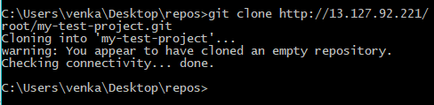
Cloning the Repository
Go to the Project Dashboard and copy the repository clone URL. It should look somewhat like this:
http://ec2-174-129-137-118.compute-1.amazonaws.com/root/my-test-project.git
Replace the “ec2-174-129-137-118.compute-1.amazonaws.com” with http://13.127.92.221 and copy the updated URL.
Open your terminal and type the following command:
git clone http://13.127.92.221/root/my-test-project.git

Slide 47
Cloning the Repository
If you experience a Windows password error:
In some versions of Microsoft Windows operating system and Git you might see an error similar to :
fatal: could not read
Password for 'https://emmap1@bitbucket.org': No such file or directory
If you get this error, enter the following at the command line and repeat the previous step:
git config --global core.askpass
You will be prompted for the password, after typing it, the process will successfully continue.
You already knew that your repository was empty right? Remember that you have added no source files to it yet.

Slide 48
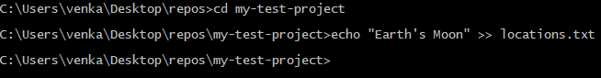
Adding a File to the Local Repository
Add a file to your local repository and put it on Gitlab
With the repository on your local system, it's time to get to work. You want to start keeping track of all your space station locations. To do so, let's create a file about all your locations.
Go to your terminal window and navigate to the top level of your local repository.
cd ~/repos/my-test-project/
Enter the following line into your terminal window to create a new file with content.
echo "Earth's Moon" >> locations.txt
If the command line doesn't return anything, it means you created the file correctly!

Slide 49
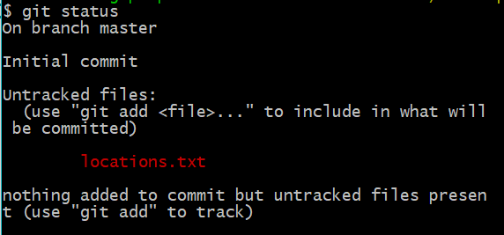
Get the status of your local repository
The git status command tells you about how your project is progressing in comparison to your Bitbucket repository.
At this point, Git is aware that you created a new file, and you'll see something like the image shown.
The file is untracked, meaning that Git sees a file not part of a previous commit. The status output also shows you the next step: adding the file.

Slide 50
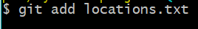
Adding File to Commit
Tell Git to track your new locations.txt file using the git add command:
git add locations.txt
Just like when you created a file, the git add command doesn't return anything when you enter it correctly.
The git add command moves changes from the working directory to the Git staging area. The staging area is where you prepare a snapshot of a set of changes before committing them to the official history.

Slide 51
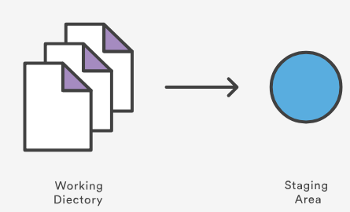
Adding File to Commit
Tell Git to track your new locations.txt file using the git add command:
git add locations.txt
Just like when you created a file, the git add command doesn't return anything when you enter it correctly.
The git add command moves changes from the working directory to the Git staging area. The staging area is where you prepare a snapshot of a set of changes before committing them to the official history.

Slide 52
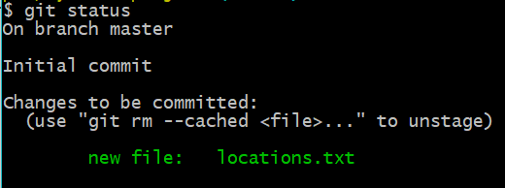
Check the Status
The git status command displays the state of the working directory and the staged snapshot.
git status
Now you can see the new file has been added (staged) and you can commit it when you are ready.

Slide 53
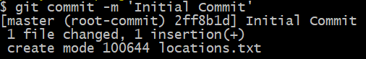
Git Commit
The git commit takes the staged snapshot and commits it to the project history. Combined with git add, this process defines the basic workflow for all Git users.
Issue the git commit command with a commit message, as shown on the next line. The -m indicates that a commit message follows.
git commit -m ‘Initial commit’

Slide 54
Git Commit
The git commit takes the staged snapshot and commits it to the project history. Combined with git add, this process defines the basic workflow for all Git users.
Issue the git commit command with a commit message, as shown on the next line. The -m indicates that a commit message follows.
git commit -m ‘Initial commit’

Slide 55
Note
Up until this point, everything you have done is on your local system and invisible to your Bitbucket repository until you push those changes.

Slide 56
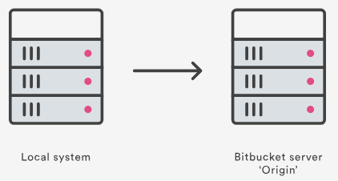
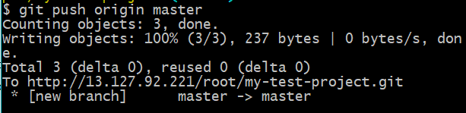
Pushing the Changes
Go back to your local terminal window and send your committed changes to the repository using:
git push origin master.
This command specifies that you are pushing to the master branch (the branch on Git) on origin server.
Your commits are now on the remote repository (origin).

Slide 57
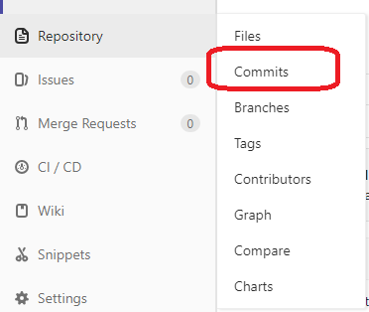
Pushing the Changes
Go to your my-test-project repository on Gitlab.
If you click “Commits” under “Repository” in the sidebar, you'll see a single commit on your repository. Gitlab combines all the things you just did into that commit and shows it to you.
Remember how the repository looked when you first created it? It probably looks a bit different now.

Slide 58
Pull changes from your Git repository

Slide 59
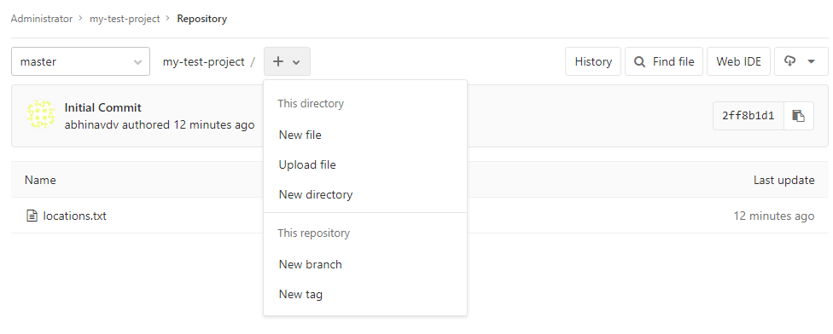
Creating New File in Gitlab
Go to your my-test-project repository on Gitlab.
If you click “Files” under “Repository” in the sidebar, you'll see the files page.
Click the + beside the “Master”. This button only appears after you have added at least one file to the repository.
A page for creating the new file opens.

Slide 60
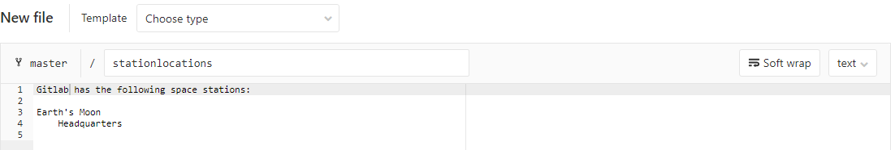
Creating New File in Gitlab
Enter stationlocations in the filename field.
Add the following text into the text box:
Gitlab has the following space stations:
Earth's Moon
Headquarters
Note that the file name and text can be anything of your choice.

Slide 61
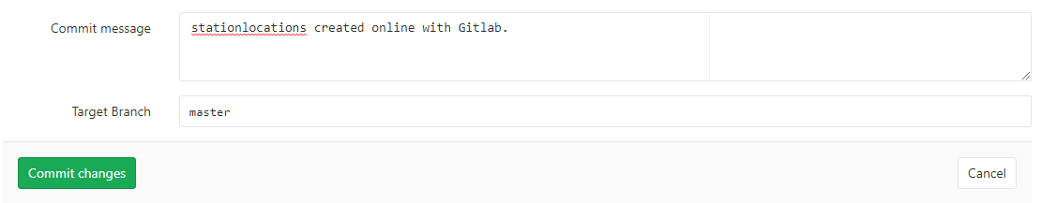
Creating New File in Gitlab
In the Commit message field enter the commit text . In this case:
stationlocations created online with Gitlab.
Click Commit under the message field. Leave the Target Branch as Master.

Slide 62
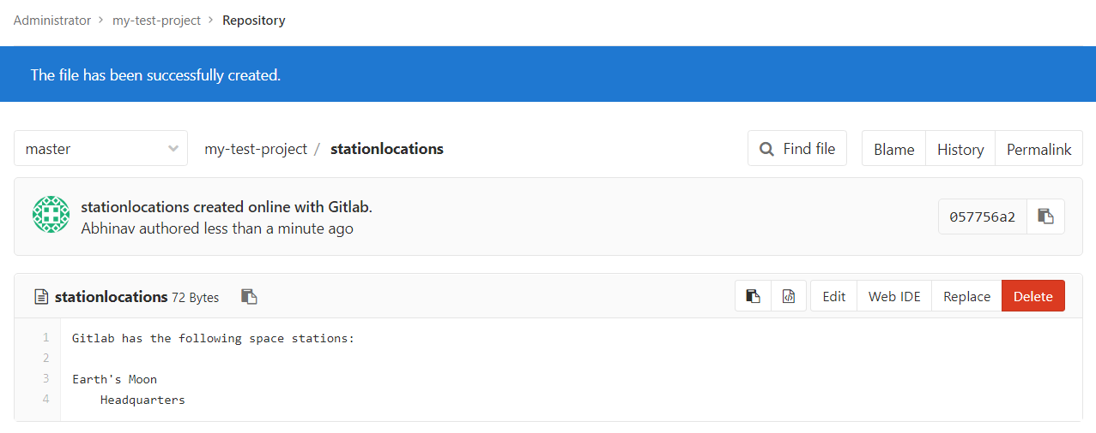
Creating New File in Gitlab
You now have a new file! You are taken to a page with details of the commit, where you can see the change you just made.
If you want to see a list of the commits you've made so far, click Commits in the sidebar.

Slide 63
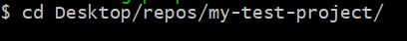
Pull changes from a remote repository
Now we need to get that new file into your local repository.
The process is pretty straight forward, basically just the reverse of the push you used to get the locations.txt file into Gitlab.
Go to your my-test-project directory using your commandline:
cd /repos/my-test-project

Slide 64
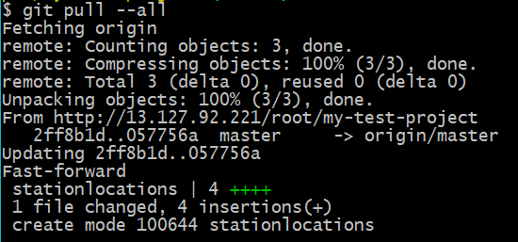
Pull changes from a remote repository
Enter the git pull --all command to pull all the changes.
git pull --all
In more complex branching workflows, pulling and merging all changes might not be appropriate .
Enter your password when asked for it.
The git pull command merges the file from your remote repository (Bitbucket) into your local repository with a single command.
Navigate to your repository folder on your local system and you'll see the file you just added.

Slide 65
Use a Git branch to merge a file

Slide 66
Branching
Sometimes you’ll need to keep information locked down.
Branches are most powerful when you're working on a team. You can work on your own part of a project from your own branch, pull updates, and then merge all your work into the main branch when it's ready.

Slide 67
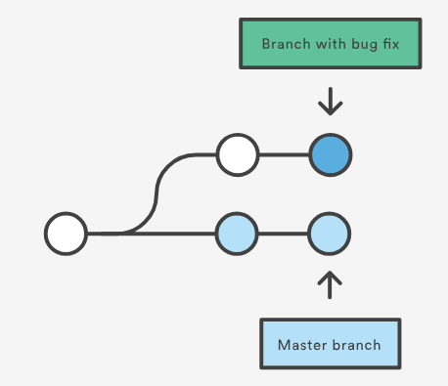
Branching
A branch represents an independent line of development for your repository.
Think of it as a brand-new working directory, staging area, and project history
Before you create any new branches, you automatically start out with the main branch (called master ).
For a visual example, this diagram shows the master branch and the other branch with a bug fix update.

Slide 68
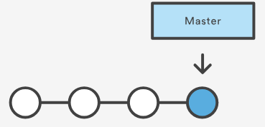
Create a branch and make a change
To create a branch, do the following:
Go to your terminal window and navigate to the top level of your local repository and Create a branch from your terminal window using the following command:
git branch future-plans
Before you begin, your repository looks like this:

Slide 69
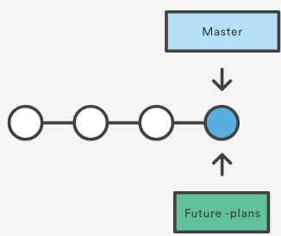
Create a branch and make a change
This command creates a branch but does not switch you to that branch, so your repository looks something like this:
The repository history remains unchanged. All you get is a new pointer to the current branch.
To begin working on the new branch, you have to check out the branch you want to use.

Slide 70
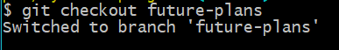
Checkout Branch
Checkout the new branch you just created to start using it.
git checkout future-plans
The git checkout command works hand-in-hand with git branch .
Because you are creating a branch to work on something new, every time you create a new branch (with git branch), you want to make sure to check it out (with git checkout) if you're going to use it.

Slide 71
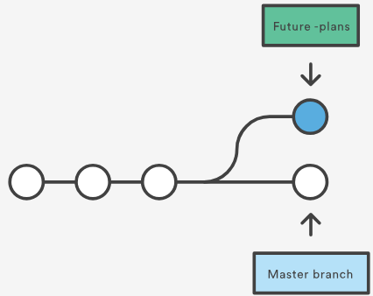
Checkout Branch
Now that you’ve checked out the new branch, your Git workflow looks something like this:

Slide 72
Checkout Branch
Search for the my-test-project folder on your local system and open it.
You will notice there are no extra files or folders in the directory as a result of the new branch.
Open the stationlocations file using a text editor.
Make a change to the file by adding another station location:
Mars
Recreation Department
Save and close the file.

Slide 73
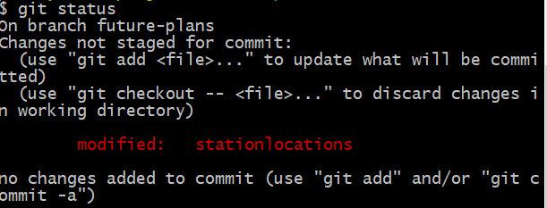
Checkout Branch
Enter git status in the terminal window.
Before you stage or commit a change, always check this line to make sure the branch where you want to add the change is checked out.

Slide 74
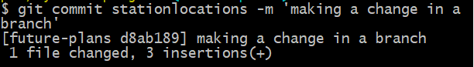
Checkout Branch
Stage your file.
git add stationlocations
Enter the git commit command in the terminal window, as shown with the following:
git commit stationlocations -m 'making a change in a branch'

Slide 75
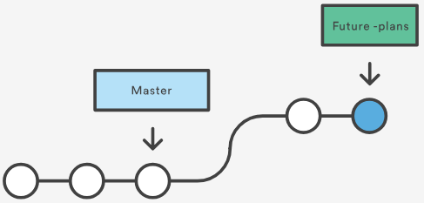
Checkout Branch
With this recent commit, your repository looks something like this:
Now it's time to merge the change that you just made back into the master branch.

Slide 76
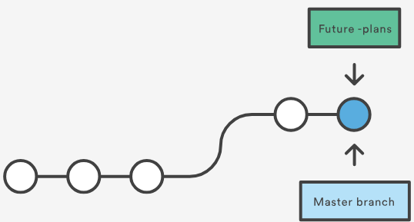
Merge your branch
Fast-forward merging
Because you created only one branch and made one change, use the fast-forward branch method to merge.
You can do a fast-forward merge because you have a linear path from the current branch tip to the target branch.
This branch workflow is common for short-lived topic branches with smaller changes and are not as common for longer-running features.

Slide 77

Merge your branch
To complete a fast-forward merge do the following:
Go to your terminal window and navigate to the top level of your local repository and enter the git status command to be sure you have all your changes committed and find out what branch you have checked out:
git status

Slide 78

Merge your branch
Switch to the master branch.
git checkout master

Slide 79

Merge your branch
Merge changes from the future-plans branch into the master branch. The command will look something like this:
git merge future-plans
You've essentially moved the pointer for the master branch forward to the current head.

Slide 80

Merge your branch
Enter git status to see the results of your merge.
This shows that your local repository is one ahead of your remote repository.

Slide 81

What we have done till now
Here's what we have done so far:
Created a branch and checked it out
Made a change in the new branch
Committed the change to the new branch
Integrated that change back into the main branch
Next, we need to push all this work back up to, your remote repository.

Slide 82

Push your change to Gitlab
Here's how to push your change to the remote repository:
From the repository directory in your terminal window, enter the following command to push the changes:
git push origin master

Slide 83

Push your change to Gitlab
Click the Activity Button on the top left corner and notice you can see your push in the Recent Activity stream.

Slide 84
Collaborative Development

Slide 85

Collaborative Development
Users typically need to share a series of commits rather than a single changeset. Instead of committing a changeset from a working copy to the central repository, Git lets you share entire branches between repositories.
But what if your team is working on some remote project, and you want to be able to collaborate on the same repo?
Such cases call for the Merge / Pull Requests and Code Reviews

Slide 86

Code Reviews / Pull Request Reviews
Reviews allow collaborators to comment on the changes proposed in pull requests, approve the changes, or request further changes before the pull request is merged.
Repository administrators can require that all pull requests are approved before being merged.
Repository owners and collaborators can request a pull request review from a specific person. Organization members can also request a pull request review from a team with read access to the repository.
Reviews allow for discussion of proposed changes and help ensure that the changes meet the repository's contributing guidelines and other quality standards

Slide 87

Merge / Pull Requests
Pull requests are a feature that makes it easier for developers to collaborate.
They provide a user-friendly web interface for discussing proposed changes before integrating them into the official project.
In your Gitlab environment, the Merge requests button helps you raise a request.

Slide 88

Merge / Pull Requests
In their simplest form, pull requests are a mechanism for a developer to notify team members that they have completed a feature.
This lets everybody involved know that they need to review the code and merge it into the master branch.

Slide 89

Anatomy of a Merge/Pull Request
When you file a pull request, all you’re doing is requesting that another developer (e.g., the project maintainer) pulls a branch from your repository into their repository.
This means that you need to provide 4 pieces of information to file a pull request:
the source repository,
the source branch,
the destination repository, and
the destination branch.

Slide 90


Slide 91
Creating a Merge/Pull Request

Slide 92
Creating a Merge/Pull Request
There are 2 main work flows when dealing with pull requests:
Pull Request from a forked repository
Pull Request from a branch within a repository
Here we are going to focus on the second one.

Slide 93

Creating a Topical Branch
First, we will need to create a branch from the latest commit on master.
Make sure your repository is up to date first using:
git pull origin master
git pull does a git fetch followed by a git merge to update the local repo with the remote repo.

Slide 94


Creating a Topical Branch
To create a branch, use
git checkout -b <new-branch-name> [<base-branch-name>],
where base-branch-name is optional and defaults to master.
let’s create a new branch called pull-request-demo from the master branch and push it to github.

Slide 95
Creating a Merge/Pull Request
To create a pull request, you must have changes committed to the your new branch.
Go to the repository page on gitlab. And click on "Merge Request" button in the repo header.
Gitlab calls the “pull requests” as “merge requests”. Going ahead, we will use them interchangeably.

Slide 96

Pick a Project
Pick the project you wish to have merged using the "Select Project" dropdown.
You should leave the rest of the fields as is, unless you are working from a remote branch. In that case, just make sure that the base repo and base branch are set correctly.
You will be redirected to the “New Merge Request” page.

Slide 97

Compare Branches
You will be redirected to the “New Merge Request” page.
Select the Source branch and Target branch as applicable.
Click on “Compare Branches and continue”

Slide 98

Merge Request Description
Enter a title and description for your pull request.
Sometimes, the title is given as default.
Remember you can use Github Flavored Markdown in the description and comments

Slide 99

Merge Request
You should now see an open pull request page.

Slide 100


Using a Merge Request
You can write comments related to a pull request,
view all the commits by all contained by a request under the commits tab,
or see all the file changes from the pull request across all the commits under the "Files Changed" tab.

Slide 101

Merging a Pull Request
Let’s say the assignee adds and updates some of the files that you assigned.
Once you and your collaborators are happy with the changes, you start to merge the changes back to master. There are a few ways to do this.
One way is clicking on the “Merge” button

Slide 102

Check out, review, and merge locally
Another way is using the commandline.
Step 1. Fetch the branch for this merge request
git fetch origin

Slide 103

Check out, review, and merge locally
Check out the branch for this merge request
git checkout -b revert-94ddf271 origin/revert-94ddf271

Slide 104

Check out, review, and merge locally
Step 2. Review the changes locally and manually.
Step 3. Merge the branch and fix any conflicts that come up
git checkout pull-request-demo
git merge --no-ff revert-94ddf271

Slide 105

Check out, review, and merge locally
Step 4: Push the result of the merge to GitLab
git push origin pull-request-demo

Slide 106

Merged Requests
If it executes successfully, you would see a “Merged by <Assignee>” message in your dashboard.

Slide 107
Closing a Pull Request
You can simply click on the "Close" button on the pull request to close it. Optionally, you can delete the branch directly using the "Delete this branch" button.

Slide 108
END

